Slide 1
ME 592X: Data Analytics and Machine Learning for Cyber-Physical Systems Applications
Lecture 11
Programming for Deep Learning
Aditya Balu
Spring 2019

Slide 2
Motivation
Exposure to Deep Learning Platforms
Efficient programming for DL
Tips for dealing with large data for DL
Alternative good sources:
https://cs230-stanford.github.io/project-code-examples.html

Slide 3
Deep Learning Training
Load Data
Define Model
Define learning strategy
Train
Load Test Data
Validate
Deploy
Simplest code for this: https://github.com/adityabalu/PDL/blob/master/Keras/mnist_cnn.py

Slide 4
Warmup Exercise (python)
Predict the output of these code snippets
class A(object):
"""docstring for A"""
def __init__(self, a=4, b=10, c=20):
self._a = a
self._b = b
self._c = c
@property
def a(self):
return self._a
@property
def b(self):
return self._b
@property
def c(self):
return self._c
def __repr__(self):
return "A Object"
if __name__ == '__main__':
a = A(4,6,8)
print(a)
print(a.a)
print(a.b)
print(a.c)
Source: https://github.com/adityabalu/PDL.git

Slide 5
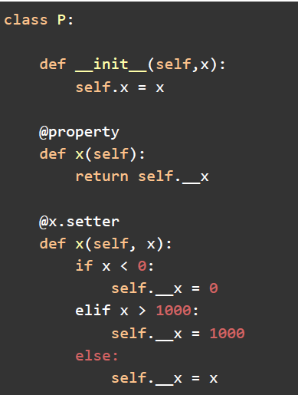
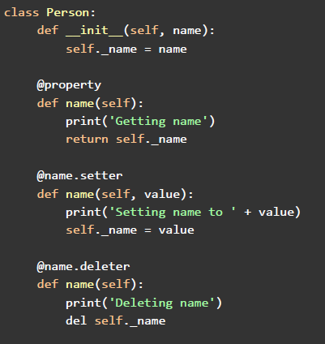
Property method (complete implementation)

Slide 6
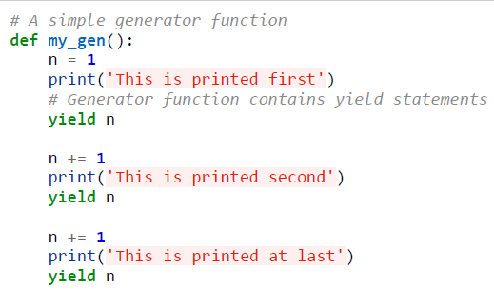
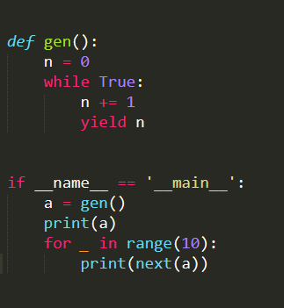
Generators (warmup)

Slide 7
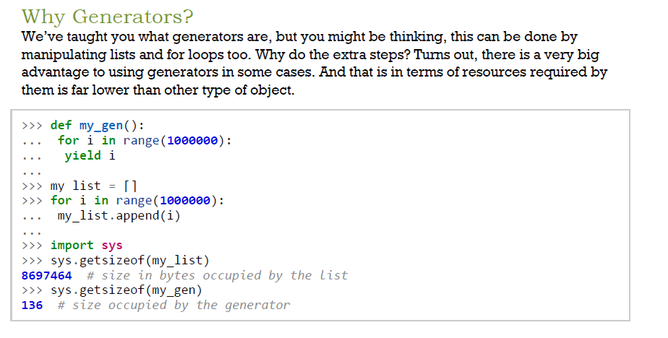

Slide 8
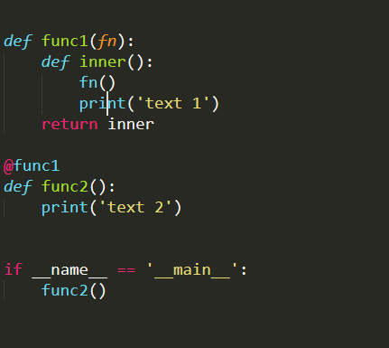
Decorators

Slide 9
Data Generators/Pipelines

Slide 10
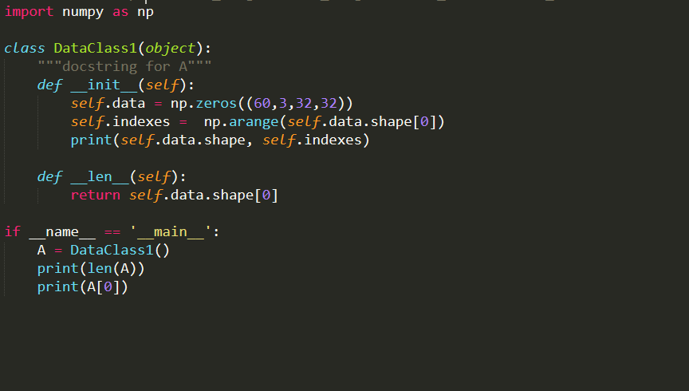
More Python fundamentals

Slide 11
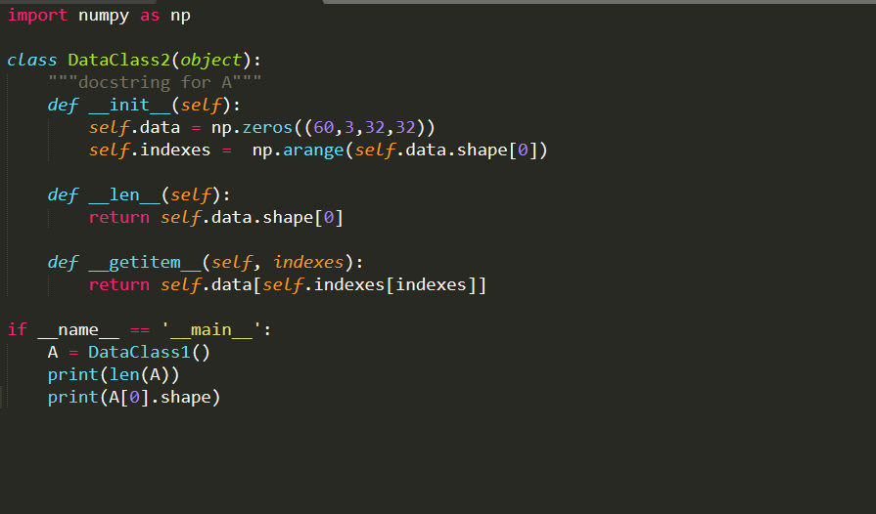
getitem method

Slide 12
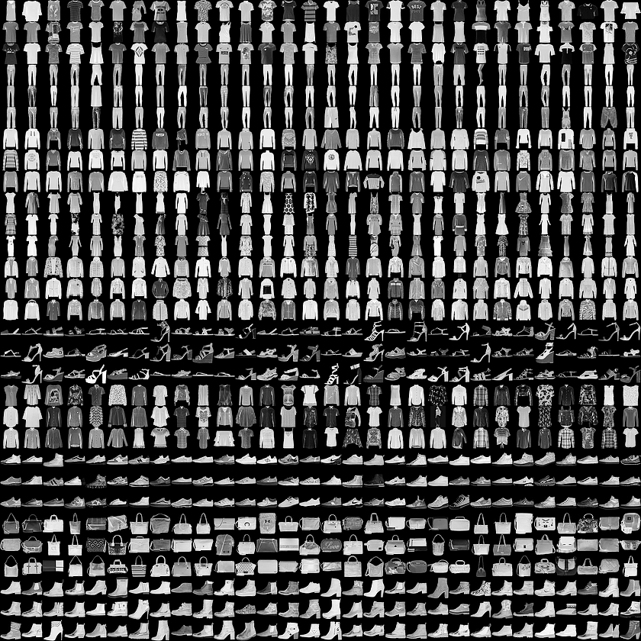
Naïve Implementation of a Data Loader (Fashion MNIST)
Fashion MNIST: https://github.com/zalandoresearch/fashion-mnist

Slide 13
Naïve Implementation
https://github.com/adityabalu/PDL/blob/master/DataProcessors/naive.py

Slide 14
Data Pipelines
Performing Preprocessing “on-the-fly”
PCA/ZCA Whitening
Normalization
Data Augmentation
One-hot encoding
Dealing with Big Data such as 14 billion images
Multi-processing

Slide 15
Data Pipelines in Keras
Simple Method:
Process all the data and feed to keras, it will do iterations etc.
Generator Method:
Advanced Method:
https://github.com/adityabalu/PDL/blob/master/DataProcessors/keras.py
Good Reading Sources:
https://blog.keras.io/building-powerful-image-classification-models-using-very-little-data.html
https://stanford.edu/~shervine/blog/keras-how-to-generate-data-on-the-fly
https://github.com/mdbloice/Augmentor

Slide 16
Data Pipelines in Pytorch
import torch.utils.data as data
Inherit:
class TopoDataset(data.Dataset):
Sources:
https://cs230-stanford.github.io/tensorflow-input-data.html

Slide 17
Data Pipelines in Tensorflow
Create tf.data.Dataset
Load from .tfrecords
Load from generators

Slide 18
Learning Algorithms and Implementations

Slide 19
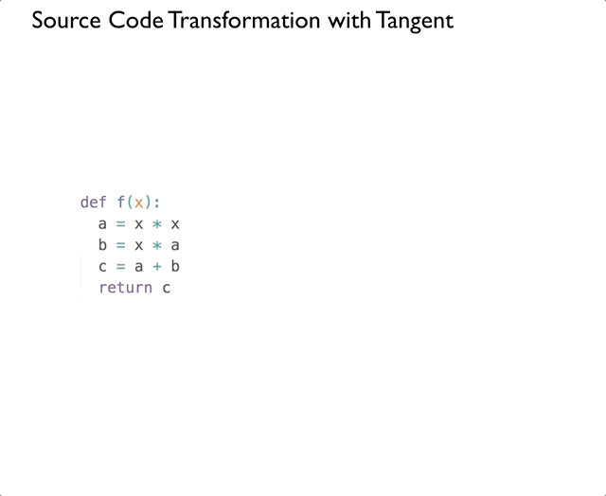
Back-propagation

Slide 20
Convolution, Max-pool and Dense Layer Backprop

Slide 21
ReLu, sigmoid, and linear Backprop

Slide 22
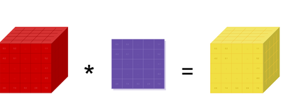
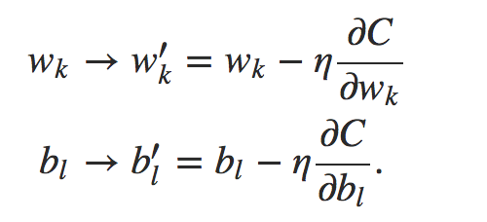
Challenges in implementing Deep Learning Algorithms
Naïve Example: https://towardsdatascience.com/lets-code-a-neural-network-in-plain-numpy-ae7e74410795
Huge Tensor Computations
Gradient Computations for optimization

Slide 23
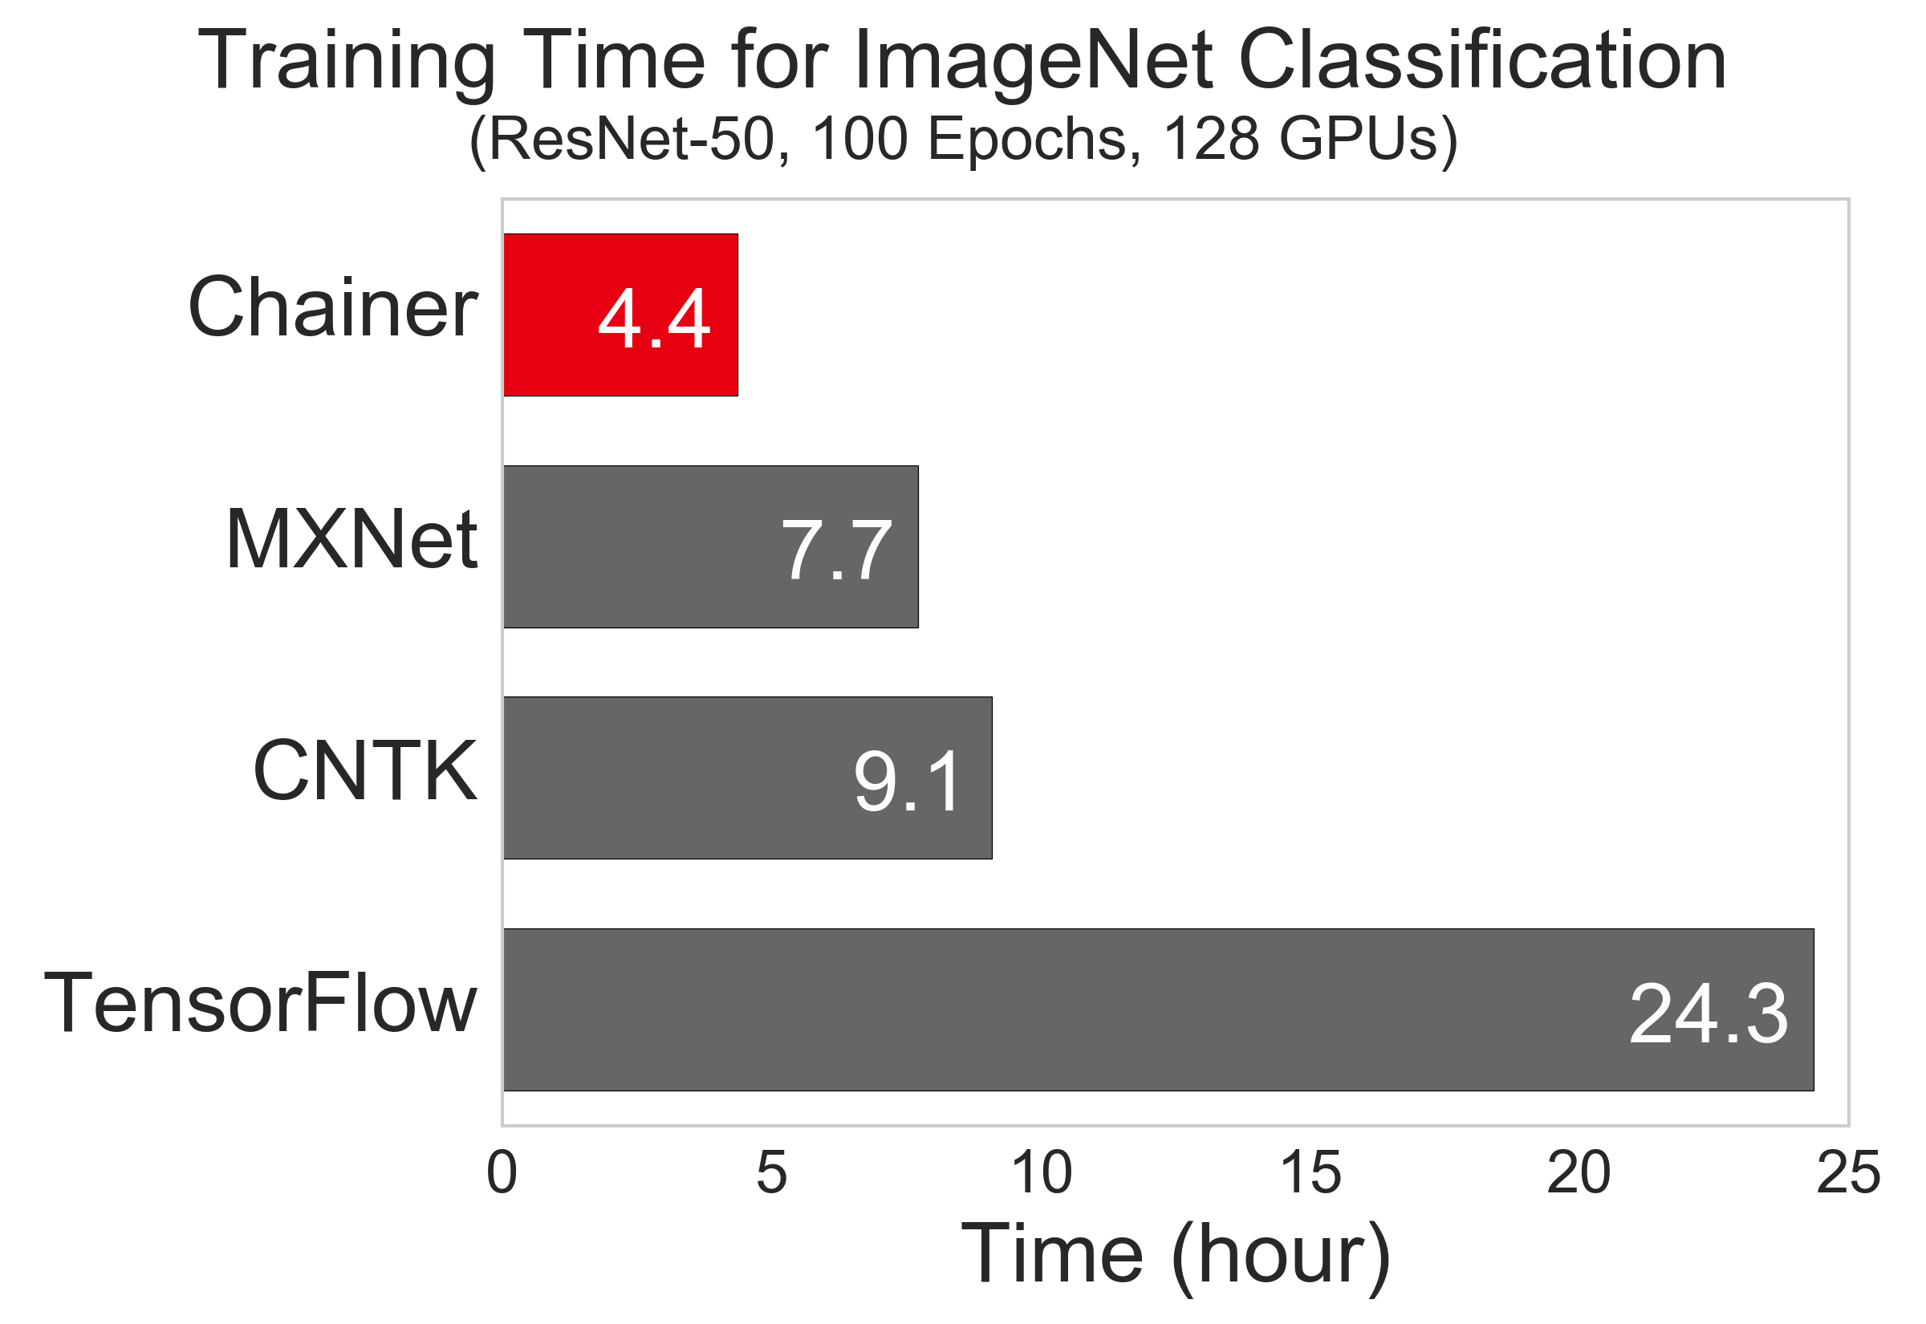
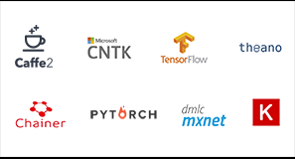
Platforms
Theano
Tensorflow
Caffe
MX Net
CNTK
Torch
Chainer
[1]: https://chainer.org/general/2017/02/08/Performance-of-Distributed-Deep-Learning-Using-ChainerMN.html

Slide 24
About the Platforms
Theano | University of Montreal, 2009
Torch | NYU/Facebook AI Research, 2000
Caffe | Berkeley AI Research Lab, 2013
Tensorflow | Google Brain, 2015
MXNet | DMLC, 2015
CNTK | Microsoft, 2016
Chainer MN | Preferred Networks, 2017

Slide 25
Choose the platform
Language
Multi-GPU implementation
Computational Time
Computational Graph
Property | Theano | TensorFlow | Torch | Caffe | CNTK | MX Net
Language | Python | C++/Python | Lua | C++ | C++/Python | C++/Python/R
Multi-GPU | NA | Yes | Yes | Partially | Yes | Yes
Computation backend | Python | C++ | C | C++ | C++ | C++
[1] https://developer.nvidia.com/deep-learning-frameworks
[2] https://arxiv.org/pdf/1608.07249.pdf
[3] https://arxiv.org/pdf/1511.06435.pdf

Slide 26
Wrappers to the Deep Learning Platforms
Keras (Framework in itself)
TF Slim
Lasagne
PyTorch
MatCaffe

Slide 27
Keras
Keras
Tensorflow
Theano
CNTK
A high-level programming library for Deep Learning
Written in Python
Three backends
Supports both convolutional networks and recurrent networks, as well as combinations of the two
Runs seamlessly on CPU and GPU

Slide 28
Dependencies for Keras
Dependencies
Theano and its dependencies
TensorFlow and its dependencies
CNTK and its dependencies
GPU Support
CUDA Toolkit
CuDNN Toolkit

Slide 29
Recommended Hardware Requirements
CPU RAM
Dependent on Data
Typically more than 8Gb
GPU
Nvidia GPU w/ compute capability greater than 3
Need 4-6Gb of GPU Memory

Slide 30
Model Creation
Sequential API
from keras.models import Sequential
from keras.layers import Dense, Activation model = Sequential()
model.add(Dense(units=64, input_dim=100))
model.add(Activation('relu’))
model.add(Dense(units=10))
model.add(Activation('softmax’))
Functional API
from keras.models import Model
from keras.layers import Input, Dense
inputs = Input(shape=(784,))
y1 = Dense(64, activation='relu')(inputs)
y2 = Dense(64, activation='relu’)(y1)
predictions = Dense(10, activation='softmax’)(y2)
model = Model (inputs=inputs, outputs=predictions)

Slide 31
Layers
Convolutional Layers
Pooling
Recurrent Layers
Normalization Layers
Wrapper layers such as:
Convolutional Recurrent layers
Bidirectional RNN layers

Slide 32
Loss Function
MSE
MAE
Cross entropy
KL Divergence
Can create your own loss function

Slide 33
Optimizer
SGD
RMSProp
Adam
Adadelta
Adagrad
Custom Optimizer

Slide 34
Activations
Softmax
Relu
Sigmoid
Linear
Tanh
Elu
Advanced activation functions possible

Slide 35
Callbacks
Data storage strategy
Learning Strategy like early stopping, decaying step size
Data visualization strategy

Slide 36
Pretrained Models
VGG16/VGG19 w/ ImageNet weights
Inception and inceptionV3 models
Can save and reload models in JSON file
Also save and reload trained weights

Slide 37
Keras Demo
https://github.com/adityabalu/PDL/blob/master/Keras/mnist_cnn.py

Slide 38
Useful Links:
http://ankivil.com/installing-keras-theano-and-dependencies-on-windows-10-python-34/
https://keras.io/
https://github.com/tensorflow/tensorflow
https://www.continuum.io/downloads
http://deeplearning.net/software/theano/
https://www.tensorflow.org/install/
Hopefully, Keras should work fine!

Slide 39
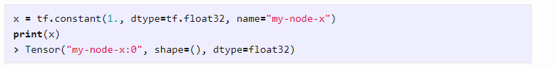
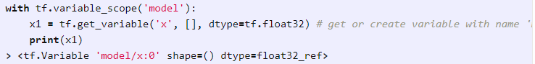
Tensorflow
Symbolic graph language
Has apis for C++, Python, Java, C#, Javascript etc.
Graph, Session and nodes
Placeholders and tf.data
Scope:

Slide 40
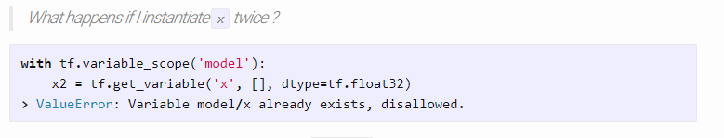
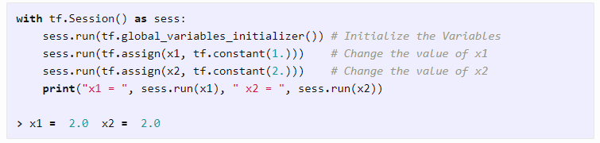
Tensorflow Execution
Execution:

Slide 41
Tensorflow for MNIST
Example 1: https://github.com/adityabalu/PDL/blob/master/Tensorflow/example1.py
MNIST CNN:
https://github.com/adityabalu/PDL/blob/master/Tensorflow/mnist_cnn.py
More Examples: https://github.com/aymericdamien/TensorFlow-Examples/tree/master/examples

Slide 42
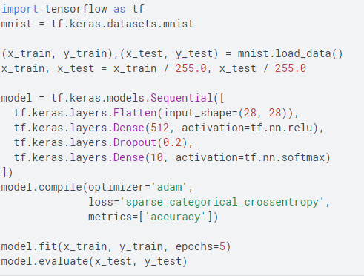
tf.keras

Slide 43
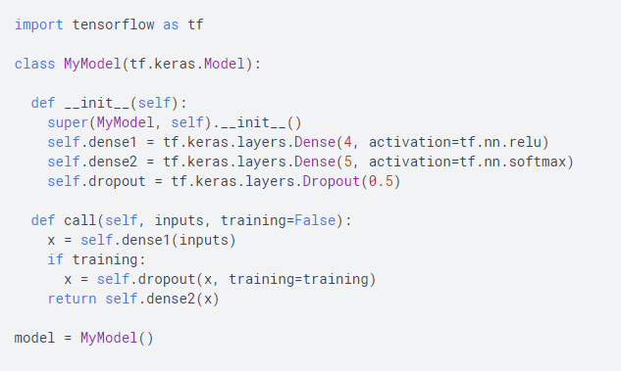
Subclassing api

Slide 44
Class structure
Class Layer():
__init__() #initialize weights and non-trainable constants
__call__()/forward() #forward computation
backward() # backprop

Slide 45
Pytorch
MNIST CNN: https://github.com/adityabalu/PDL/blob/master/Pytorch/mnist_cnn.py

Slide 46
Advantages and Disadvantages
TF:
Very difficult development
Lot of deployment support
Keras:
Very handy for applications and quick experiments
Doesn’t have all the features needed
Pytorch:
Object oriented/Pythonic coding and very flexible
Useful for all applications, deployment packages still in development

Slide 47
Challenges
CPU memory
Data pipelines
GPU memory
Batch size
no. of parameters of network
shape of each layer output

Slide 48
Architectures
AlexNet
ZF Net
GoogLeNet (Inception)
Microsoft ResNet
Depthwise Separable Convolutions
Xception
MobileNet

Slide 49
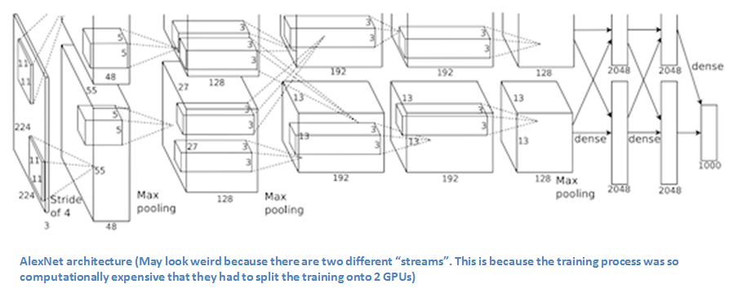
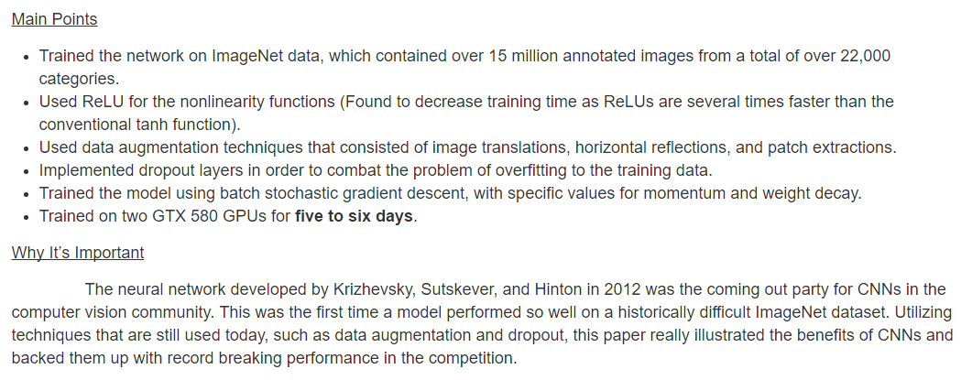
AlexNet (2012)
The network was made up of
5 Conv layers
Max-Pooling layers
Dropout layers
3 Fully Connected layers.

Slide 50
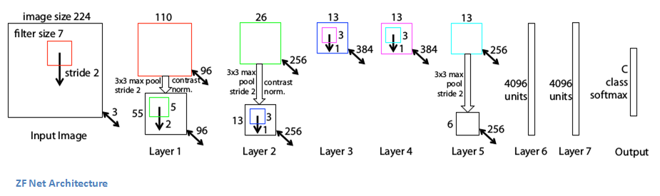
ZF Net (2013)
Very similar architecture to AlexNet, except for a few minor modifications.
AlexNet trained on 15 million images, while ZF Net trained on only 1.3 million images.
Instead of using 11x11 sized filters in the first layer (which is what AlexNet implemented), ZF Net used filters of size 7x7 and a decreased stride value. The reasoning behind this modification is that a smaller filter size in the first conv layer helps retain a lot of original pixel information in the input volume. A filtering of size 11x11 proved to be skipping a lot of relevant information, especially as this is the first conv layer.
As the network grows, we also see a rise in the number of filters used.
It is this paper which introduces the feature visualization, named DeConvNet
VGG also has a similar learnings (salient feature, simple and deep)

Slide 51
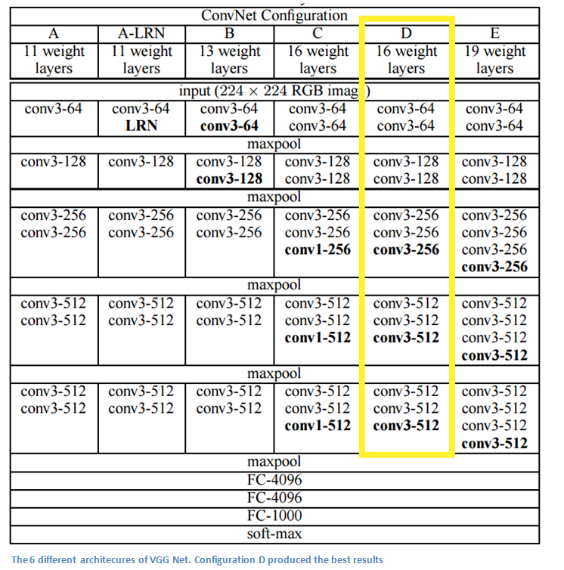
VGG Net (2014)
There are two architectures:
VGG16
VGG19
Key features: No z-scoring, no preprocessing

Slide 52
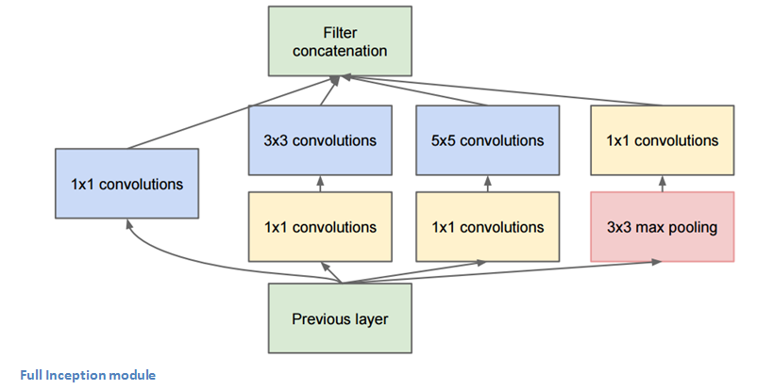
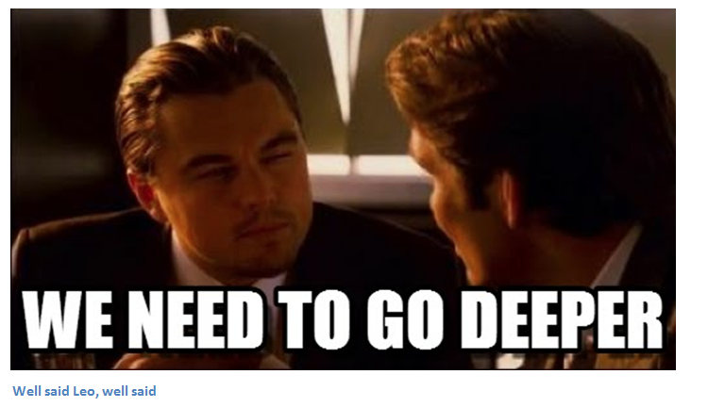
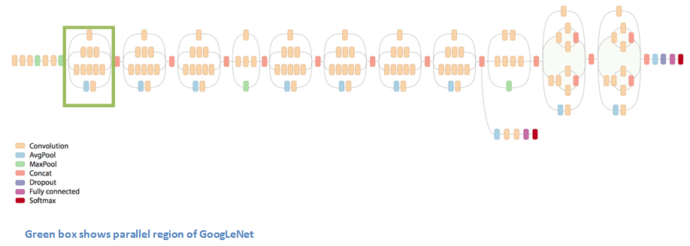
GoogLeNet (2015)
Used 9 Inception modules in the whole architecture, with over 100 layers in total! Now that is deep…
No use of fully connected layers! They use an average pool instead, to go from a 7x7x1024 volume to a 1x1x1024 volume. This saves a huge number of parameters.
Uses 12x fewer parameters than AlexNet.

Slide 53
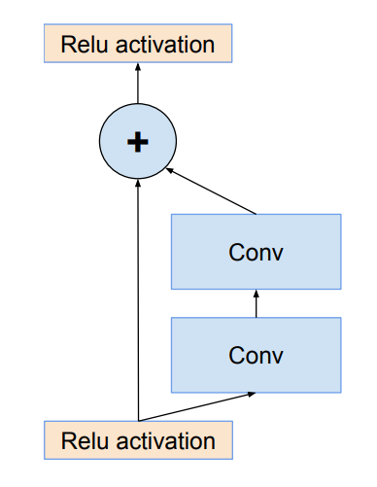
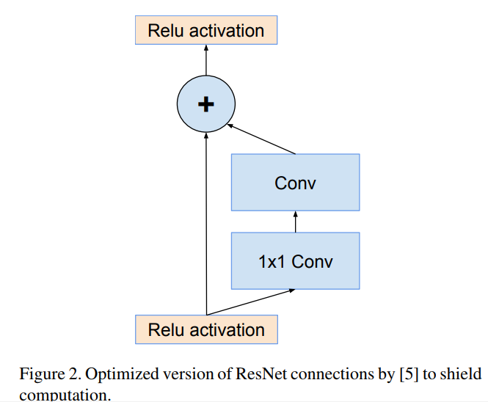
Microsoft ResNet (2015)
152 layers…
Interesting note that after only the first 2 layers, the spatial size gets compressed from an input volume of 224x224 to a 56x56 volume.
Authors claim that a naïve increase of layers in plain nets result in higher training and test error (Figure 1 in the paper).
The group tried a 1202-layer network, but got a lower test accuracy, presumably due to overfitting.

Slide 54
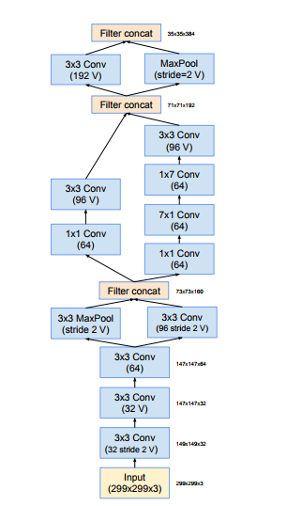
Inception-ResNet (V1-V4)(2016)
Improvement to inception and ResNet

Slide 55
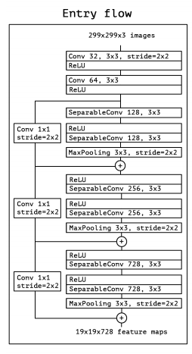
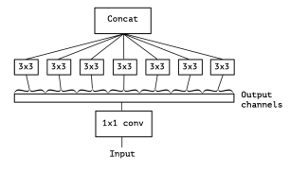
Xception(2017)
Separable Convolutions

Slide 56
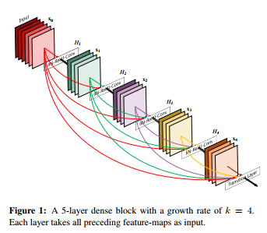
DenseNet (2017-2018)
Use Dense Layers as connections and concatenate

Slide 57
General Design Principles
Avoid Representational Bottlenecks
Increasing the activations per tile in a convolutional network allows for more disentangled features
Spatial aggregation can be done over lower dimensional embeddings without much or any loss in representational power
Balance the width and depth of the network

Slide 58
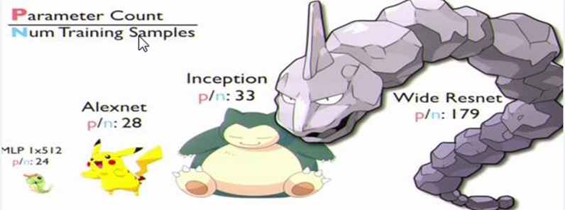
Concluding Remarks

Slide 59
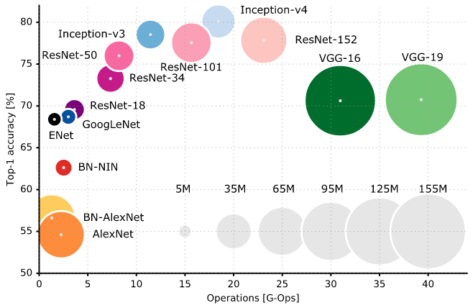
Comparison

